Slide 1
Timebox 4 - Spotify Playlist Generator
BeatBuilders

Slide 2
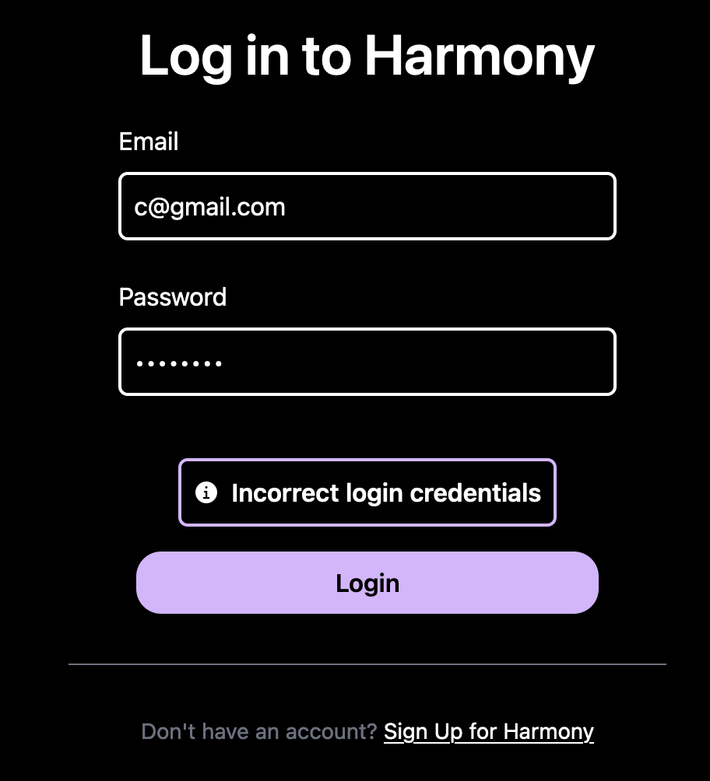
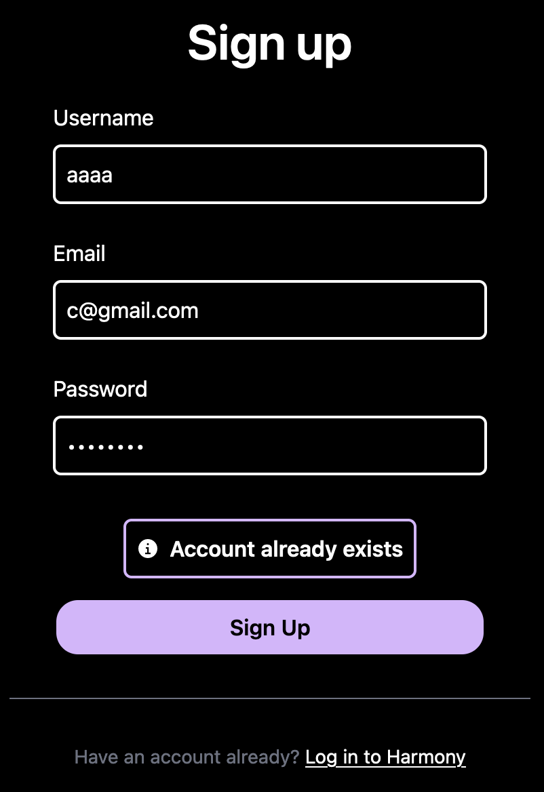
Authentication Improvements and Port Conflicts

Slide 3
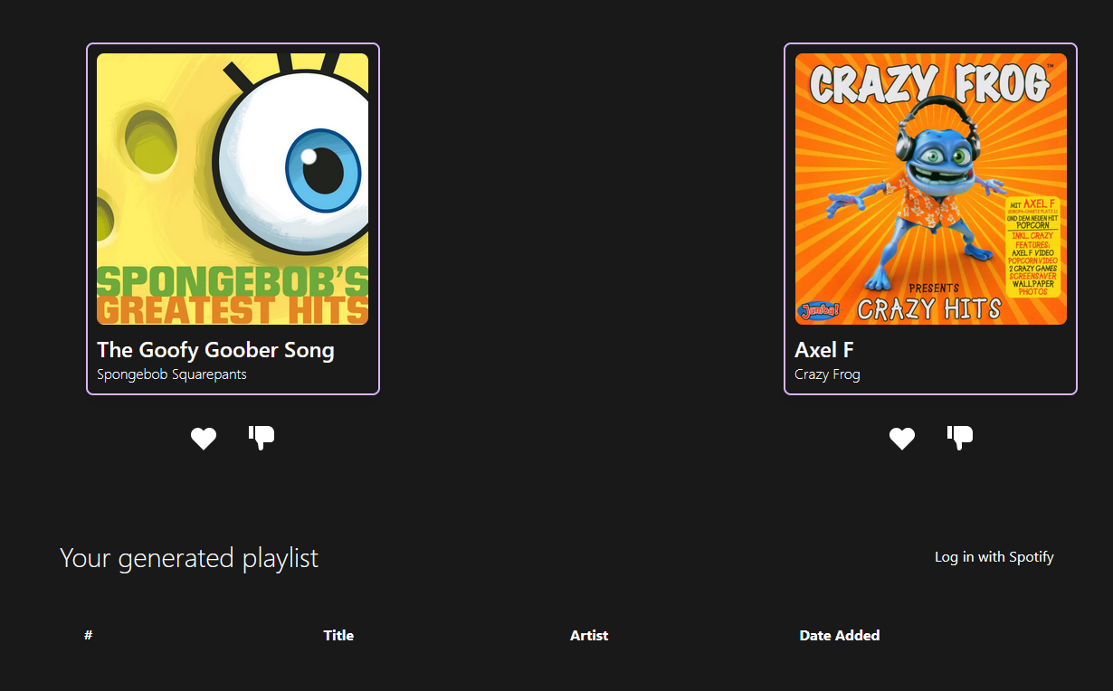
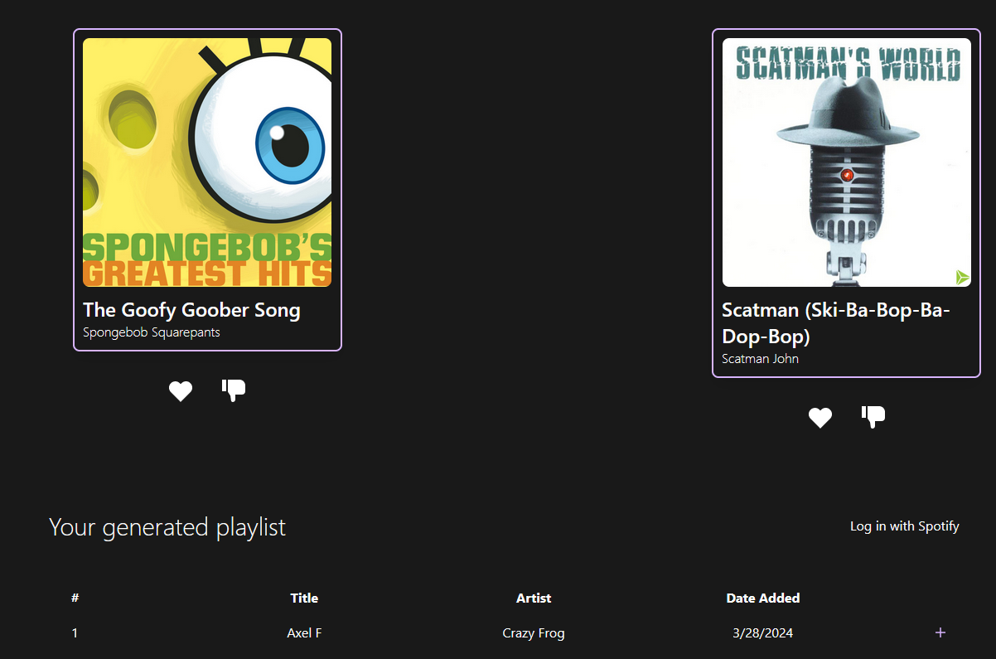

Slide 4
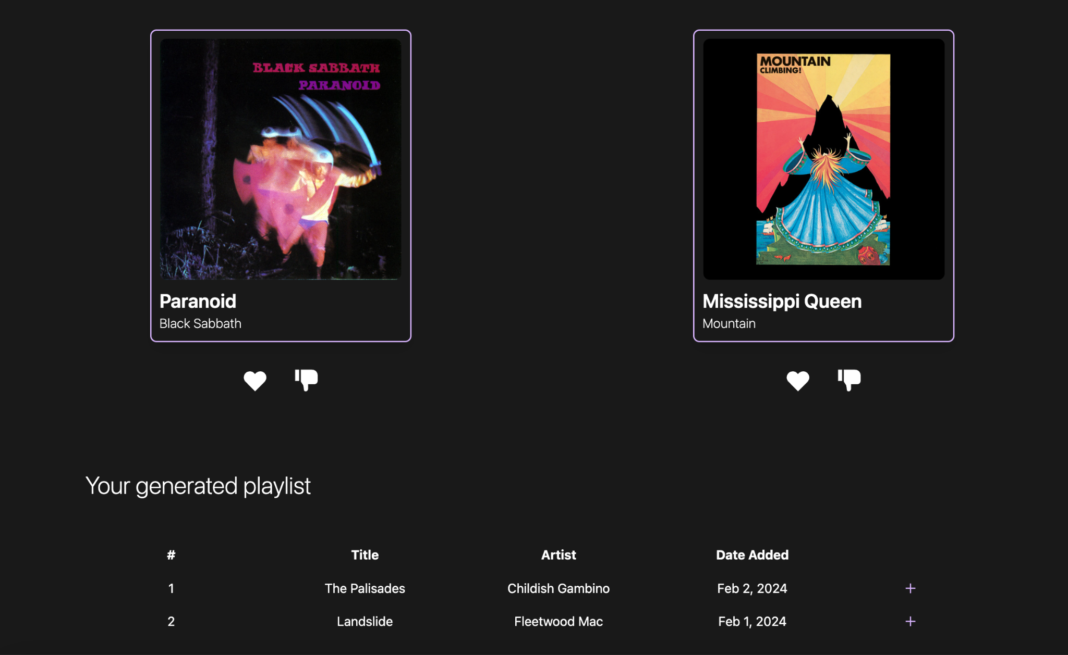
Integrating ElasticSearch Data Flow Through Front End
Starting to remove hard coded values
Rethinking how data will move through components

Slide 5

Future Playlist Caching
Save fields of the Your Playlist section so that users don’t lose their songs
Ex) key value cookie store “title=The Palisades” …
Implement cookies by using document (let’s us manipulate the DOM)
document.cookie = “title=The Palisades” - set cookie
getAllCookies= document.cookie

Slide 6
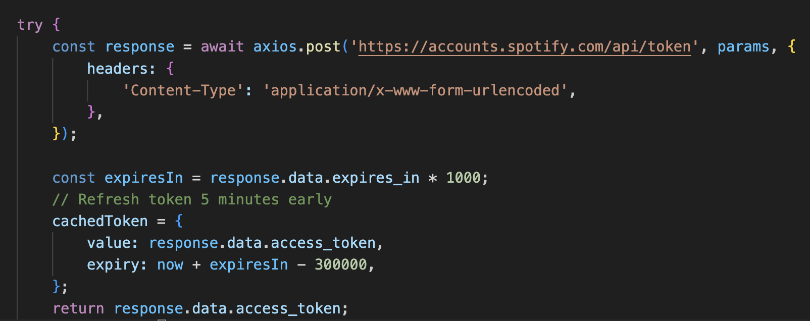
Automatic Spotify Auth Token Generation
Generates Spotify API Auth Token with client id and secret in “params”
Refreshes 5 minutes before the token expires to keep it alive

Slide 7
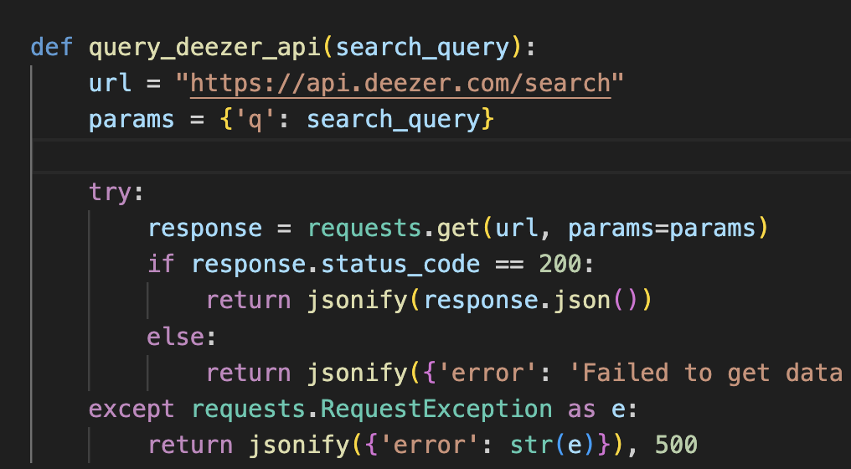
CORS Proxy Server Workaround
Used existing search query flask server for a proxy server for Deezer
This allows for access to the Deezer API without an external proxy server
All Deezer API queries are requested from the proxy server and sent to the application

Slide 8
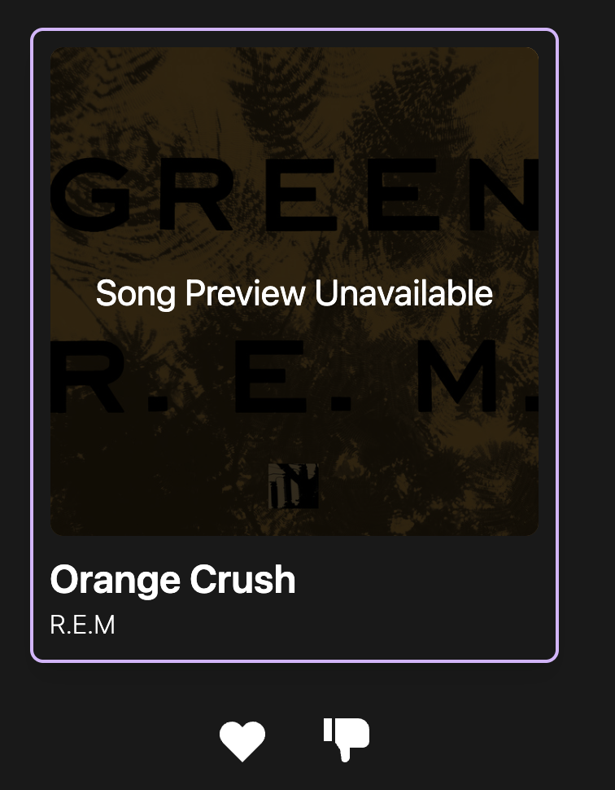
Unavailable Previews
Added a dimmed “Song Preview Unavailable” overlay when neither Spotify or Deezer has song previews
This overlay appears when you click a card that is missing a song preview link
You are still able to add the song to your playlist, as it has the Spotify track ID attributed to it

Slide 9

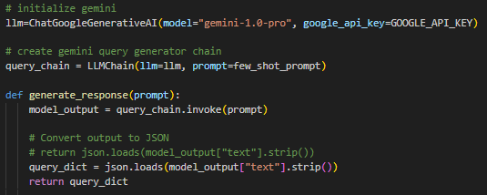

LLM Improvements!
Switched from LLama2 to Gemini API, reduced user query times from 30 seconds to 3

Slide 10
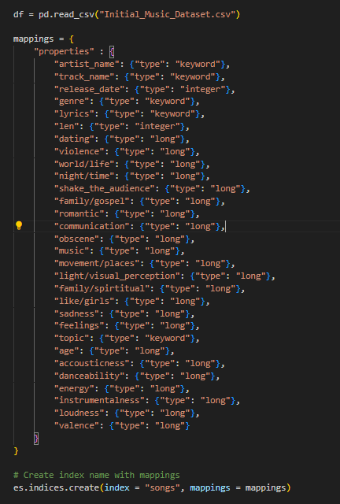
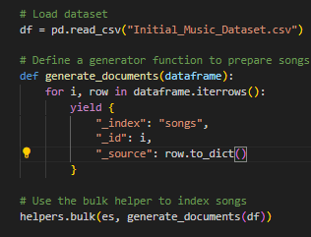
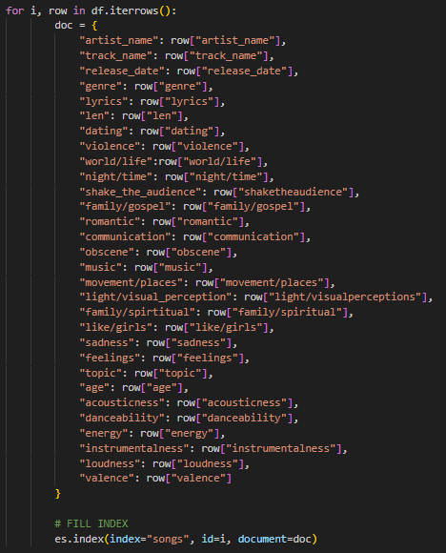
Elasticsearch index refactoring
Seemingly fixed issue where compound queries were not returning results

Slide 11
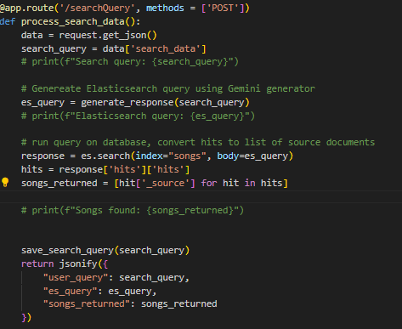
Updated Flask API to orchestrate all backend services

Slide 12
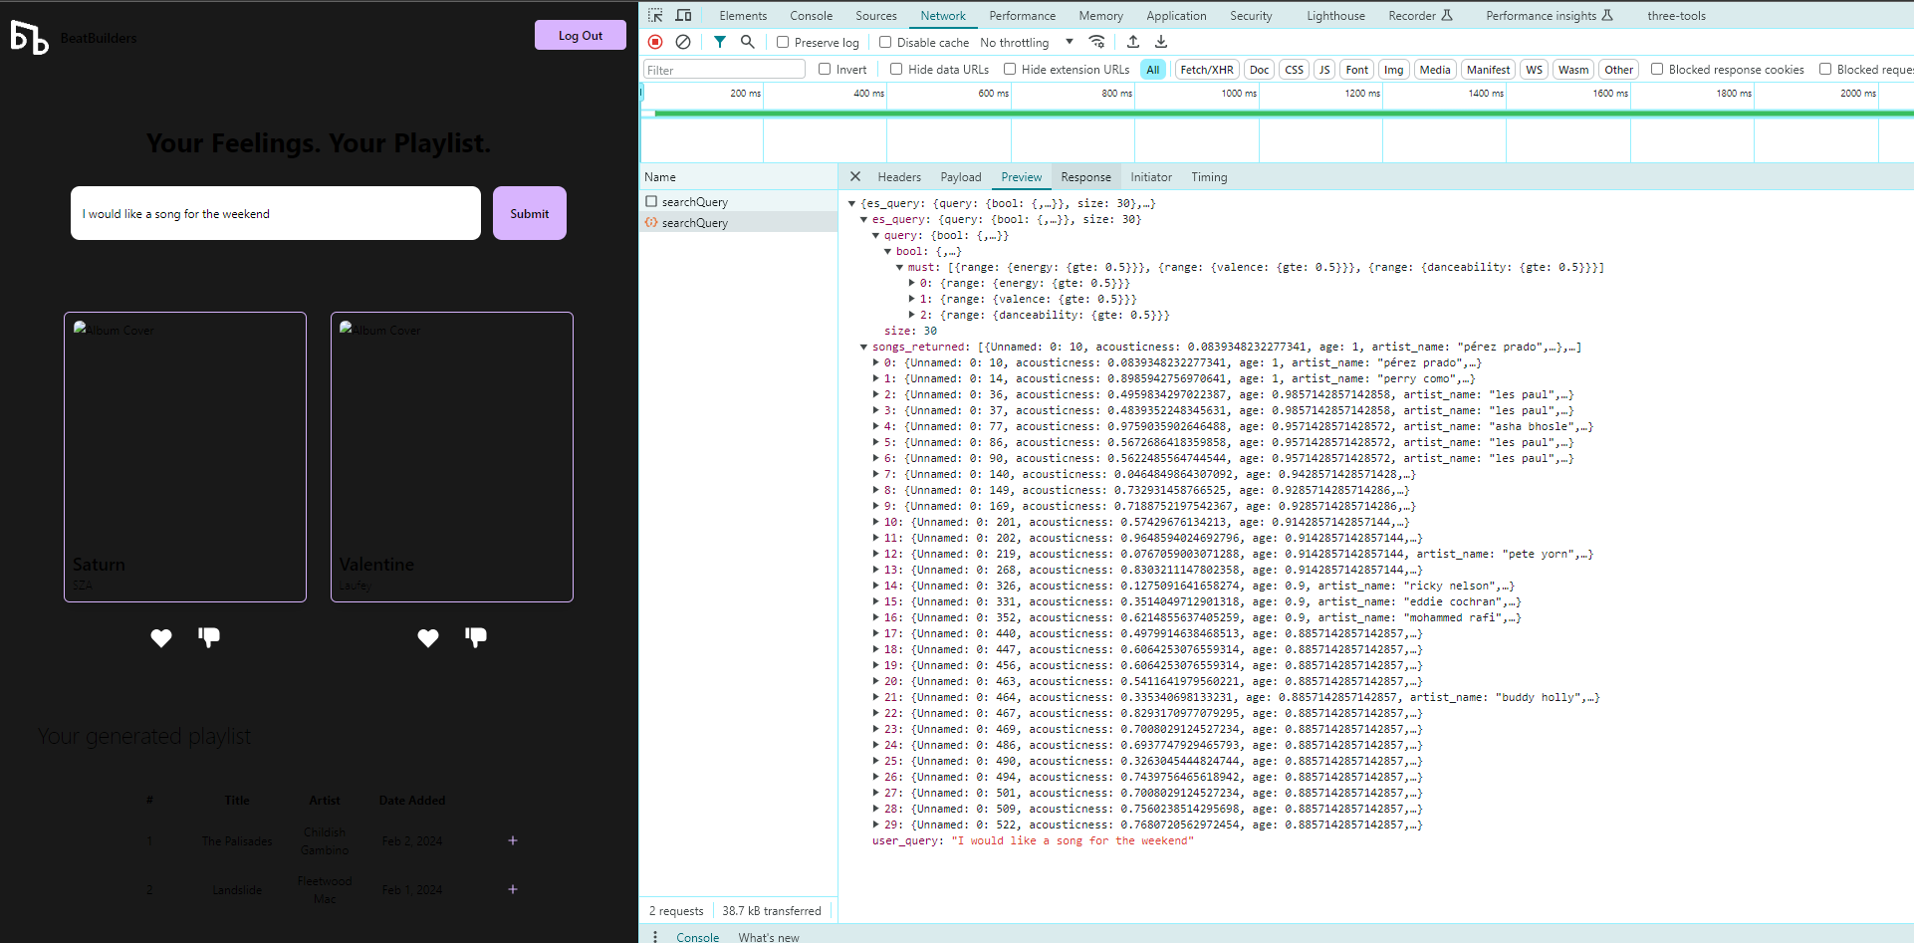
Backend workflow is working (on a branch)
LLM generated elasticsearch queries are returning hits to the front end:

Slide 13
Next Steps
Look at the songs returned, tune Gemini to the Spotify song quantifiers
Pull album art from Deezer as well, currently it is only song previews
Connect individual pieces together to get a complete draft

